Slide 1

VeriCat Disclaimers
Doctrinal Disclaimer: This VeriCat.org opensource catechesis material does not come with an ecclesial nihil obstat or imprimatur (it has not been reviewed or approved by ecclesiastical authority). It is recommended that anyone using this material should consult with their pastor or other competent authority prior to using it. Reasonable assurance of this material’s faithfulness to Catholic teaching can be obtained by searching for “LE-0523-0008” on VeriCat.org and viewing the “verification file”, which contains copious citations to Magisterial documents that support key statements in the material. Please leave a contention on this material’s webpage (VeriCat.org/LE-0523-0008) if you believe there is an error or typo in it.
Copyright Disclaimer: Under section 107 of the Copyright Act of 1976, allowance is made for “fair use” of copyrighted materials for purposes such as criticism, comment, news reporting, teaching, scholarship, education and research. Citations and limited excerpts of copyrighted material that might otherwise be infringing are permitted for “fair use” without the need for permission from the rights holder. Users contributing materials to VeriCat.org have agreed that to the best of their knowledge they have not plagiarized or violated any copyrights. If you believe a copyright infringement has occurred, please report it to director@vericat.org and we will work to resolve the issue.

Slide 2

Pro-Life
Who are the unborn, why should I care, and what do I do now?
Notes:
0:00-1:00
{{This talk is a request from a previous student of mine that said, after the year was over, “Hey, you kept saying abortion is super bad, but I don’t even know what abortion is and all my teachers at school say abortion is ok, a right even”. At which point I made this face [point to picture of surprised baby on slide] and felt like a huge failure as a teacher. [pause for laughs]}} In America today, 19% of women will have had an abortion by age 30 and if you or someone close to you has had an abortion just know we are here to love you, not condemn you {{and [name counselor/priest if one is able to provide counseling outside of the room] is available to talk if you need to step out}}. So here’s how this talk is gonna go down. First we'll discuss what abortion is in a sober, rational, loving manner. Then we’re going to eat snacks, take a break, etc. Then we'll briefly touch on end of life issues, the history of abortion in the bible and in the saints, and finally why the Pro-life movement is such an important one to join. Ok, here we go!

Slide 3

Can I kill it?
Notes:
1:00-1:50
Imagine you're washing dishes in the kitchen, and your four-year-old son walks into the room behind you, and asks a question: "Can I kill this?" What do you think your first response would be? Who of you would answer right away "yes" or "no?" Most likely, your first response would be a clarifying question: "What is it?" Or you would turn around to check for yourself. Your son could be holding any number of things - a spider, a dog, your baby. When it comes to the question of whether abortion is okay, we must first ask another question. What is it? Or, perhaps, who is it?

Slide 4
Let’s Breakdown the Definition
Abortion = ending a pregnancy
Pregnancy = having a fetus within your body
Fetus = a young human being
Abortion is ending the life of a young human being.
Notes:
1:50-3:10
Abortion is defined as the deliberate termination of a human pregnancy, most often performed during the first 28 weeks of pregnancy. Pregnancy is a state of containing and nourishing a developing embryo, fetus or unborn offspring within the body. A fetus is an unborn offspring of a mammal, in particular, an unborn human baby more than eight weeks after conception. So in simple terms, abortion is a procedure that deliberately ends the life of a human being. That is who the unborn are - human beings. And this is the foundational argument of the pro-life movement. Premise number one: it's wrong to kill an innocent human being. Premise number two: abortion kills an innocent human being. Conclusion: therefore, abortion is wrong. So why is there such a great divide in our nation on the topic of abortion, when abortion is clearly wrong? The answer to that is the divorcing of personhood and humanity through the introduction of arbitrary qualifiers - that is, defining certain traits that exclude certain humans from the title of persons and therefore from the right to life.

Slide 5
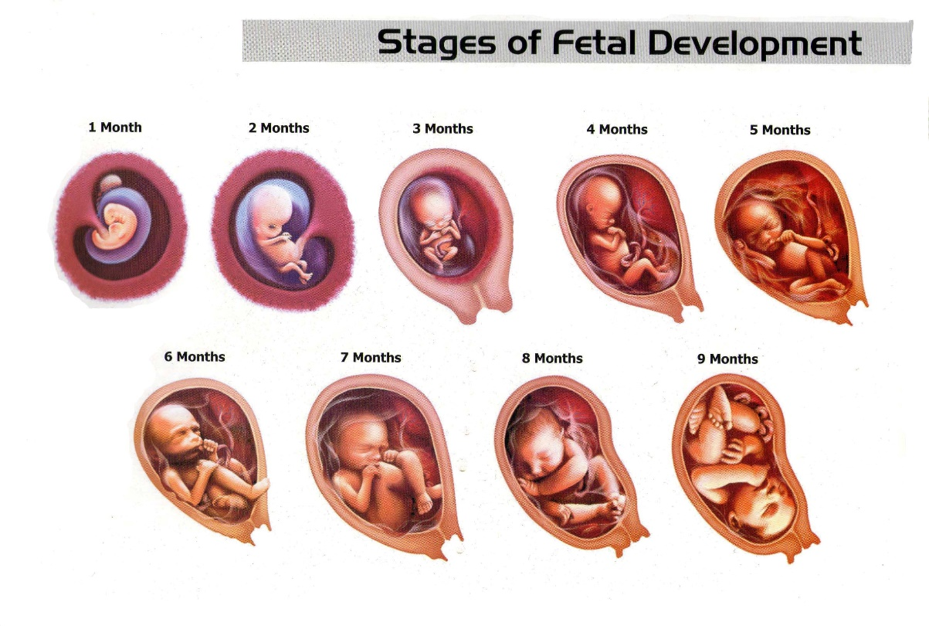
SLED
Size (small)
Level of Development (early)
Environment (womb)
Degree of Dependency (100%)
Notes:
3:10-4:30
Historically, here are some traits that have been used to exclude certain humans from personhood and the right to life. Skin color, ethnicity, religion, IQ, gender, and nationality. Most pro-choice arguments boil down to four categories of qualifiers, and these categories can be remembered by the acronym SLED.
Size, level of development, environment, and degree of dependency. Here are some examples of pro-choice arguments that you may already be familiar with.
Size- Abortion is moral because it's just a clump of cells.
Level of Development- Abortion is moral because it can't even think of feel pain yet.
Environment-Abortion is moral because it's not born yet.
Degree of dependency- Abortion is moral because it can't live without the mother.
All of these arguments do not argue against the humanity of the unborn, rather they place an arbitrary qualifier on what it means to be a human person and it takes away the right of the unborn based on those traits.

Slide 6
“Trot out the Toddler”
If abortion (the killing of an unborn child) is ok in ____________________ circumstance, would that same circumstance justify killing a born person?
Notes:
4:30-6:30
To see how this divorce of personhood and humanity is so morally bankrupt, let's apply the "Trot out the Toddler" test to each category. This test involves applying the same arguments against the personhood of the unborn to that of born humans. Size: a fetus is just a tiny cluster of cells, so it's okay to kill... A toddler is much smaller than me, so it's okay to kill? [emphasize the querying nature of the question by changing pitch and pausing briefly afterward here and throughout]
Level of development: an embryo doesn't even have a brain, so it's okay to kill... A toddler can't even read Shakespeare. So it's okay to kill?
Environment: a fetus isn't born yet, so it's okay to kill... An astronaut is no longer on planet Earth where all the other people live, so it's okay to kill?
Dependency: a fetus is entirely dependent on a woman's body to survive, so it's okay to kill... A newborn baby is entirely dependent on his or her parents for shelter and nourishment, so it's okay to kill?
As you can see, it's absolutely abhorrent to use any of those circumstances or traits to justify killing born human beings. So why do so many people find it okay to use the same arguments to justify killing unborn human beings? I think one of the biggest reasons is because the victims of the violence of abortion cannot speak for themselves and because abortion occurs behind closed doors. Many pro-choice people are ignorant of what the actual abortion procedures entail and thus do not understand why so many pro-lifers feel so strongly that it is wrong.

Slide 7
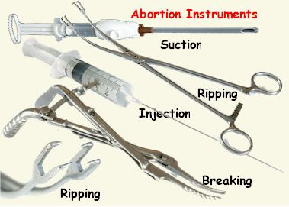
What is Abortion?
Notes:
6:30-6:55 [Video is 8 minutes 28 seconds long, assuming you have audio/visual equipment staged ahead of time and 90 seconds to transition between video and slideshow and back, then you'll be ~17 minutes into the class at return to slideshow]
Is abortion really just removing a clump of cells? Unfortunately, that is not the case. Right now, I would like to show a non-graphic video describing the different types of abortion procedures. The video does not show gory imagery, but it does show the tools used and fetal models. If at any time you feel you need to step out, you are free to do so.
[Show Oregon Right to Life’s video “Unveiling the Choice” describing each abortion procedure. Abortion Procedures: Unveiling the Choice – YouTube or see here in case YouTube takes this video down someday The Methods of Abortion – Oregon Right to Life (ortl.org) ]

Slide 8
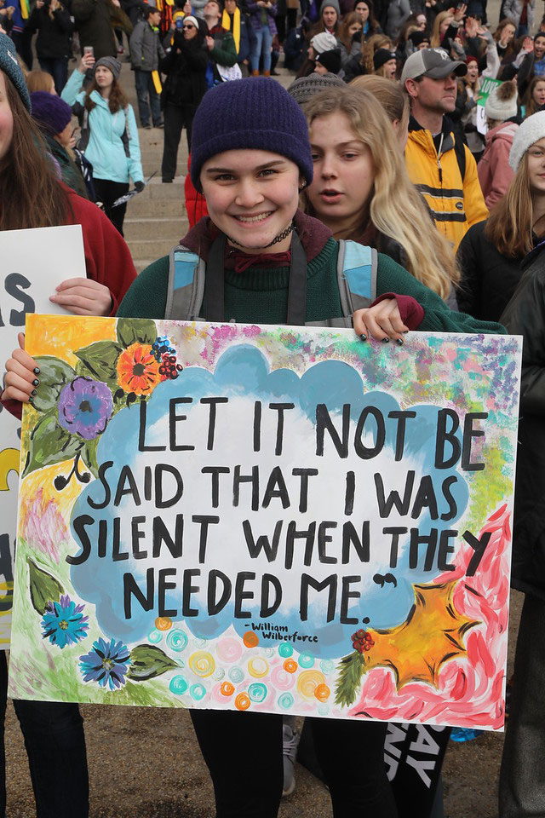

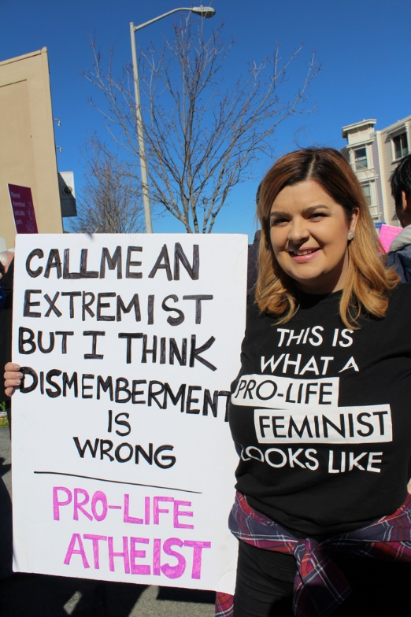

Abortion: A human rights issue
Notes:
17:00-17:50
As you now can see, abortion is not just removing a clump of cells; abortion is a human rights injustice, and it is happening by the thousands every single day in the United States alone. Since abortion was legalized in 1973, over 63.4 million human beings have lost their lives to abortion (63.4 million abortions since 1973 https://www.nrlc.org/uploads/factsheets/FS01AbortionintheUS.pdf). {{One-third of your generation (assuming average age of class is under 50)}} is missing; you are missing friends, siblings, and classmates because of abortion, and so too will the next generation, if we do not speak out against this injustice. The unborn need you to fight for them because they can't fight for themselves. I know it seems terrifying to stand against something that our nation seems to be so in support of, but do not be deceived by the mainstream media.

Slide 9
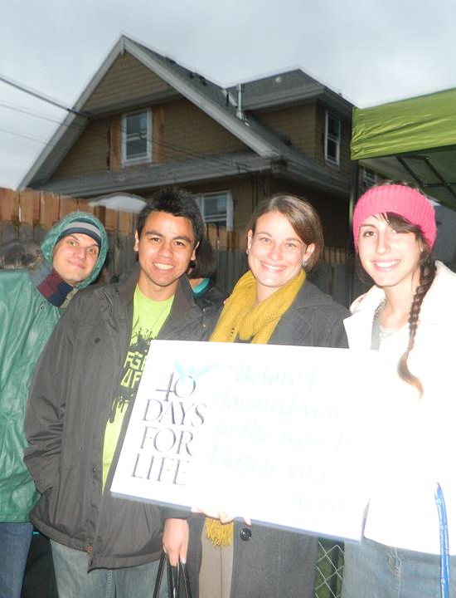
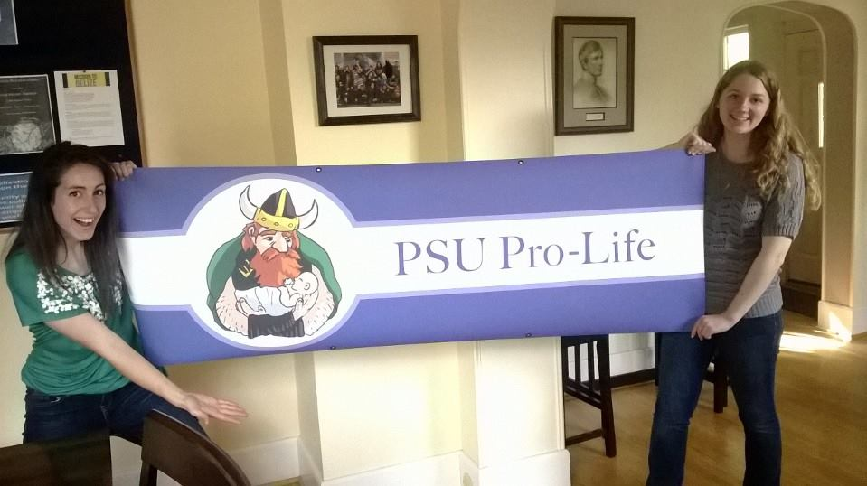
Stand Up for the Unborn
Notes:
17:50-19:20 {{You can update these photos from mine to photos of you at your pro-life group or just photos of local pro-life activities. Preferably photos of people that look like the audience you're giving the talk to and in the city the talk is being given.}}
You are not alone in this fight, and the pro-life movement isn't just religious people; we have allies in atheists, secular agnostics, feminists, and more. Hundreds of thousands of people attend the March for Life in Washington DC every year, and that number only represents the number of pro-life people who could go to that. Imagine how many more desperately wanted to go but couldn't. Be encouraged to stand up for the unborn, there are many ways you can get involved in the pro-life movement beyond just attending a march once a year. The best ways to fight for this worthy cause, are by raising awareness, praying, voting, and dialoguing. You can raise awareness by partnering and working with campus advocacy groups like the Students for Life of America who do a lot of public advocacy events, like tabling with information about abortion, or you can simply share information about abortion yourself on social media. You can pray for the pro-life cause both privately and in ministries like the 40 Days for Life prayer campaign which involves going to abortion clinics and silently praying outside them. You can vote pro-life. {{Just recently in Oregon, there were three pro-life bills that have failed to pass the committee, including a bill that advocated for pregnancy support for mothers, and a bill that called for limitations on 15 week pain capable abortions.}} We need pro-life people to vote pro-life. And lastly, you can dialogue with the people around you about abortion.

Slide 10
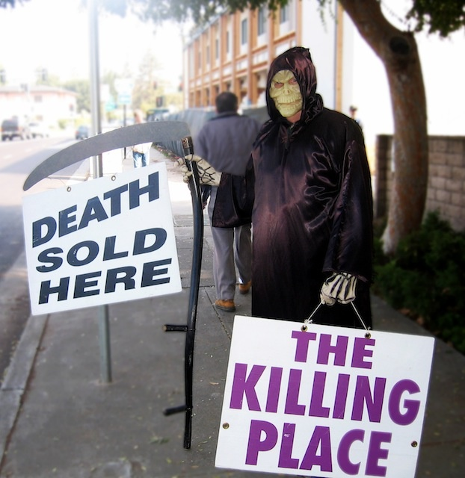
Trent Horn’s 5 Rules
DBW – Don’t Be Weird
Ask Questions
Actually Listen
Agree When Possible
Make Your Evidence Bulletproof
Notes:
19:20-21:30
I know this one can be scary because abortion is such a heated topic, so I would like to share some tips from one of my pro-life heroes, Trent Horn, on how to do so charitably and effectively. Trent Horn’s five rules for dialoguing: number one: don't be weird. Don't dress as the grim reaper outside of abortion clinics. Number two: use questions instead of statements. Oftentimes, we allow ourselves to be put on the defensive in abortion discussions, but if at all possible, try to turn the questions around on them. Even asking clarifying questions like "How would you define the term pregnancy?" can go a long way in helping people understand the issue beyond bumper sticker slogans and political rhetoric. Number three: actually listen. Not only is this just a common courtesy and decent thing to do, it's also prudent because if you’re just waiting for them to finish speaking so that you can reply, your reply probably won't even be all that effective. Number four: agree whenever possible. Nothing is more frustrating in a discussion than someone constantly shutting you down. It can make the entire conversation seem pointless and one-sided. It's important to engage them in a dialogue, not a monologue, and you can help them feel like their voices are being heard by agreeing with them whenever possible. For example, if they say that pro-life people are heartless because they only care about babies in the womb, you can agree with their sentiment that it's important to care about life outside the womb too, and that it’s frustrating when pro-life people don’t acknowledge that. Number five: Make your evidence bulletproof. Do your research about the topic and don't speak on things you don't know anything about. It's better to say you don't know than to guess. When it comes to dialoguing and knowing your stuff. One factor that is almost always relevant in the abortion debate and that I think you should know your stuff about is Planned Parenthood.

Slide 11
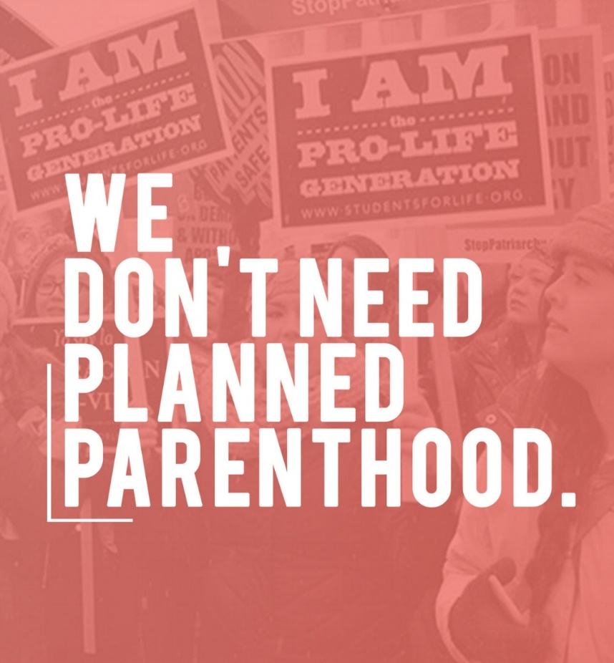
Planned Parenthood
America’s Largest Abortion Chain
300,000+ abortions a year
Taxpayer funded
20:1
Notes:
21:30-22:45
What is the deal with Planned Parenthood anyway? Planned Parenthood is the largest abortion chain in the US, and it's taxpayer-funded. They commit over 300,000 abortions per year and act like they have a monopoly on women's healthcare, but for every Planned Parenthood, there are 20 federally qualified health clinics that offer way more comprehensive care, such as mammograms and prenatal care, which Planned Parenthood rarely if ever provides (Planned Parenthood stats https://en.wikipedia.org/wiki/Planned_Parenthood, https://lozierinstitute.org/fact-sheet-reallocating-planned-parenthoods-federal-funding-to-comprehensive-health-centers/) . Women and their babies deserve better than Planned Parenthood, and they deserve better than abortion, which brings us to our next and final topic: what about the women?

Slide 12
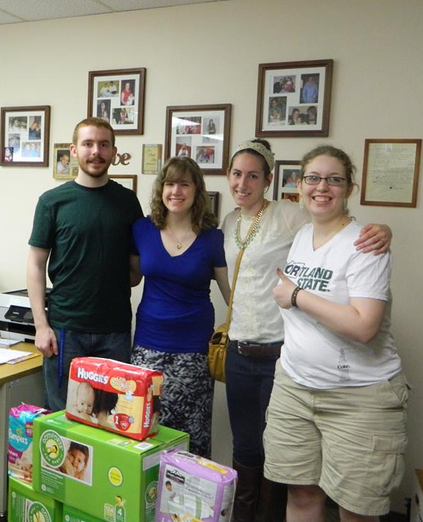
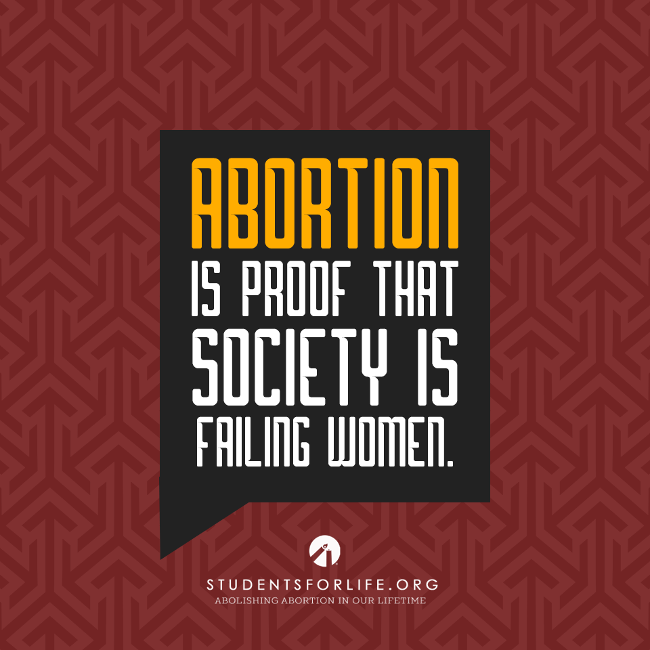
Empower Women
Notes:
22:45-24:15
It can be hard to be pro-life when you hear about the women facing unplanned pregnancies. Abortion is championed in our culture as a key to women's empowerment and that anyone who would try to restrict abortion access hates women. Rest assured, the choice of abortion is not empowerment. Yes, pregnancy, especially an unplanned pregnancy, can be extremely difficult, but women should not have to pay for their freedom from a tough situation, with the life of another innocent human being. Our culture is basically telling women that they cannot be successful, cannot get the degree or the career they want, and cannot be happy unless they abort an unwanted child. That is not empowerment, that is oppression redistributed. We need to do a better job of empowering women in their tough situations instead of telling them they can't do hard things. Women are strong and deserve better than to have their happiness and success pitted against the lives of their children. You can support abortion minded women by offering encouragement and authentic empowerment, like telling them that they are going to be awesome moms, by directing them to Pregnancy Resource Centers and other local resources that will help them with baby supplies and medical referrals, and by directly helping them in ways like committing to babysit or buying small supplies for their babies. A little help can go a long way towards empowering women to choose life.

Slide 13

Q&A
Notes:
24:15-25:00 Our culture is very pro-choice and so is the media. That doesn’t mean that the pro-life position is wrong. If you feel shaky about a pro-choice argument you see online or about a hurtful comment someone has made to you about being pro-life that you didn’t know how to defend right there on the spot – don’t assume that there isn’t a good rebuttal. There are countless resources online with the answers to all your doubts. Don’t be afraid to question your own beliefs but address those doubts with research.
[Dismiss class for a short break {{5 minute break is assumed here}}, then begin part 2 of the talk on the next slide.]

Slide 14
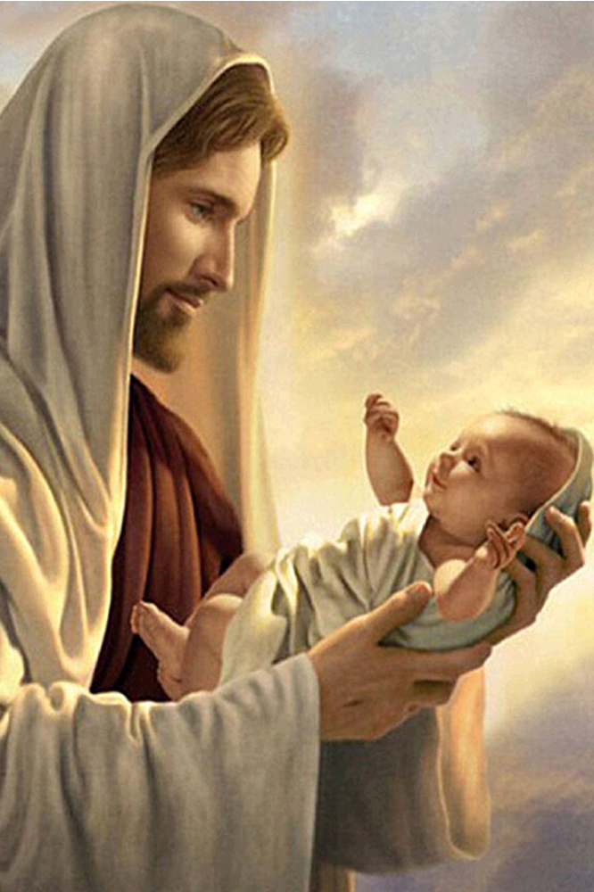
Life: God’s Greatest Gift
Every human is made in the image of God
  Protecting life is therefore a Christian duty
Notes:
30:00-31:00
Life is God’s greatest gift. In order to experience anything else, God must first create your body and soul at conception and you must be delivered from your mother’s womb.
Every human is made in the image of God. Human life is therefore a sacred thing and protecting life is therefore a Christian duty. All life, from conception to death, must be protected. If any one life is not treated as sacred… then the flood gates open towards a general feeling that no life is really [draw out pronunciation of “really” and throw voice a little] sacred. Like a sick “no one is special if everyone is special” type of an attitude.
Sadly, large swaths of our neighbors and fellow Americans have come to embrace a cold utilitarian view wherein human life is no longer sacred. It is called “the culture of death”. Let's examine other pro-life issues of caring for our elders and "assisted suicide" and then we will shift gears back to abortion.

Slide 15
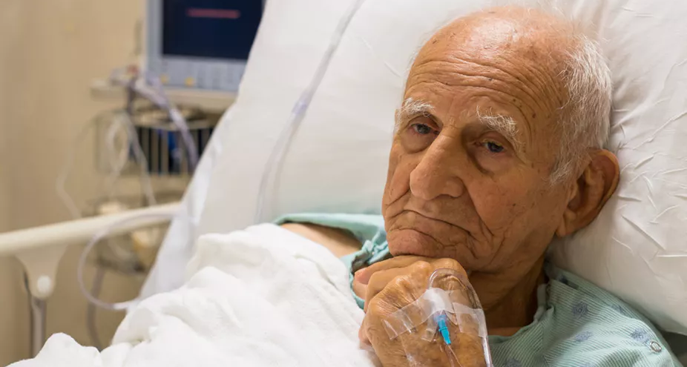
4th Commandment Versus Utility
Notes:
31:00-33:30
Some states have attempted to, and continue to attempt to, pass laws that make it legal to simply stop feeding people with dementia. I guess the ability to feed yourself is their new litmus test for personhood. Anyway, from a utilitarian perspective, it makes total sense. It takes a lot of money and effort to care for these people, roughly $100,000 per year per person just for the nursing home residence. Many of these people have no one that visit them and very few people that would care if they died. They can’t really protest it since they are out of their minds and people argue "it’s embarrassing, who would want to go on living like this? We are doing them a favor to accelerate the end".
While not as explicitly open about their intentions as some of these state lawmakers, as a nation we have similar thought processes in our policies and actions towards the elderly. Many nursing homes are poorly run, underfunded, and as a society it has become socially acceptable to neglect the elderly simply by not giving them much attention. Our actions say that we desire the elderly to die ASAP because they have lots of money in their retirement funds that we want to inherit before it is all spent on changing grandpa’s diapers and paying for his surgeries.
This is contrasted against the pro-life message of the fourth commandment: “honor your mother and father”.
Listen, Getting old is tough. It is a huge cross for the aging person to carry and it is a huge sacrifice for the people caring for them when they become high needs. As our parents and community elders age, they can no longer golf or read or play basketball, but their lives still have meaning and should be held as valuable and sacred. I’m not saying that everyone should get feeding tubes and be on life support for as long as possible. Each situation is unique and at some point we must be open to letting nature take its course and for death to come so they can go to their judgment and hopefully their eternal reward. However, we must be willing to sacrifice as individuals and as a nation for our elderly and it is fairly obvious that the ability to remember how to put a spoon to your mouth is not where the line should be drawn. {{ Having just lost a mother to dementia at an early age I take this one pretty personally. }}

Slide 16

Notes:
33:30-35:30
Oregon was the first state to legalize physician-assisted suicide, with the passing of the “death with dignity act” in 1997. Since then, 8 other states have followed suite and several others have considered it.
Again, it sounds nice [throw voice] “oh, we don’t want people to have to suffer”, “It’s not suicide, it’s ‘death with dignity’”. I don’t want to strawman their arguments so I will let you do your own research. I also don’t want you to hear my arguments and think they are the only arguments against this practice as there are many secular arguments and better-than-mine Catholic arguments available. So, I’m just going to say my take and let you visit Catholic.com and other sources if you want a deeper dive. My simple take is that if suicide is an affront to God and a rejection of his will for your life, then it is a mortal sin that is nearly impossible to repent from…. Since dead men can’t repent… then it is possibly a one way ticket to hell... which isn't good... so it is very wrong to try to encourage and enable people to commit suicide either directly via consultation or indirectly in voting.
I'd like to share a video on the subject with you now [Play "Death with Dignity" video by Christ Stefanick ~3 minutes https://www.youtube.com/watch?v=0nf_rb2qkbE ]
Just a side note as I pull this video up, it is possible that in some cases people who commit suicide may get to heaven because they are so out of their mind that their will is tainted and therefore they are not culpable. {{ I know some friends whose relatives have committed suicide and even an roommate who might have, and it leaves a big hole in people’s lives. It’s bad news and if you know someone who is suicidal talk to someone and get help cause this is a burden that they and you should not have to carry alone. }} If you happen to be suicidal, know that not every thought in your head is from you and you should reach out to our local priest.

Slide 17

Context: Mercy
Notes:
39:00-41:15
Ok, now lets shift back into the topic of abortion. In reality, despite the pro-choice rhetoric, the statistics tell a different story. Over 60% of post-abortion women surveyed said they felt pressured by others to get the abortion, received no counseling, felt rushed, were not fully informed, and that they suffered trauma.
Coercion of women into abortions can take the form of physical violence, emotional abuse, and threats against already born children amongst other tragedies from their partner and others.
There are drugs that a man can slip into a woman’s coffee in the morning that induce an abortion at any stage in the pregnancy and there have been some states that have pushed to make these drugs legal and over the counter without a prescription, allegedly to make abortion easier for a woman who chooses it, but in reality some males want to get out of their responsibilities as parents and are pretty excited to do all they can to get women to end the pregnancy. Note I refrain from calling such males "Men".
The amount of social pressure on women puts much of the sin and guilt on those pressuring them, rather than themselves (though obviously, the woman herself should seek healing in the Sacrament of Confession for her own sake).
There are Post-Abortion Resources to help you handle your grief and to heal if you have had an abortion, pressured someone into an abortion, or otherwise suffered because of abortion. For example, there is an amazing ministry called “Rachel’s Vineyard” that leads retreats for such people.
God will forgive any sin. It is the typical tactic of Satan to make you feel like something isn’t a sin and then the moment you commit the sin that it was the biggest deal and you will never be forgivable. Contrast that with the nature of the Holy Spirit who will act like a potential sin is the biggest deal to try to warn you not to do it, then after you commit the sin He immediately tries to convince you the sin was nothing compared to the ocean of his mercy... Don’t listen to the evil spirit, listen to the Holy Spirit.

Slide 18
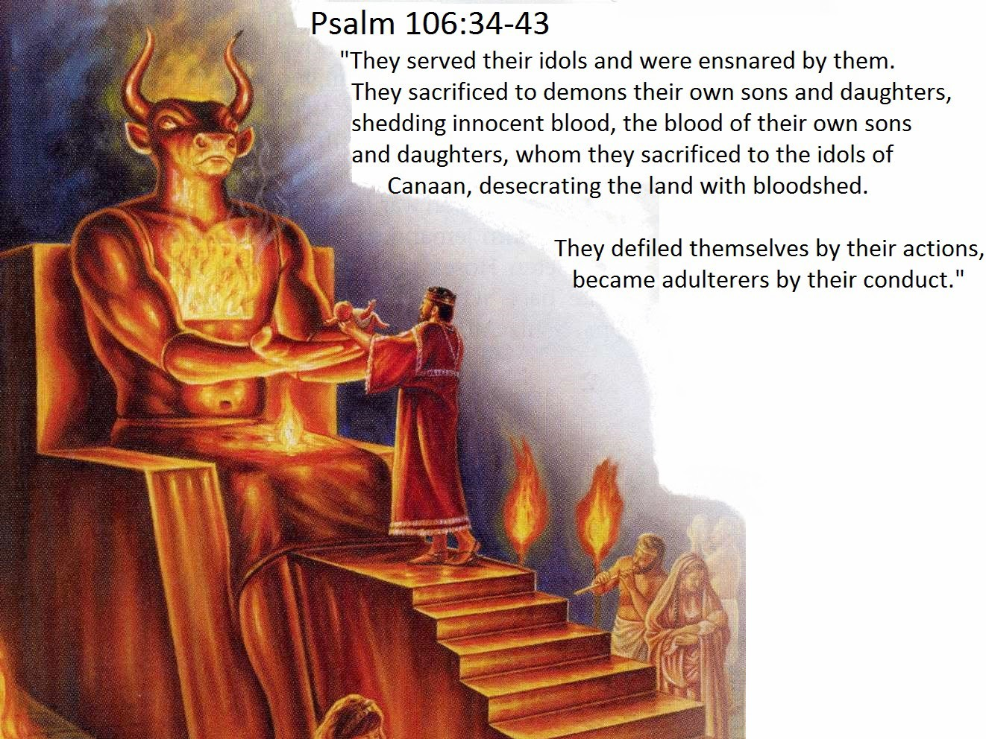
Notes:
41:15-42:00
Let's look at the history of Christians dealing with infanticide and abortion and cultures of death. As you’ll see, this is not a new issue for Christians. As it says in Psalm 106:34-43 [read quote]

Slide 19
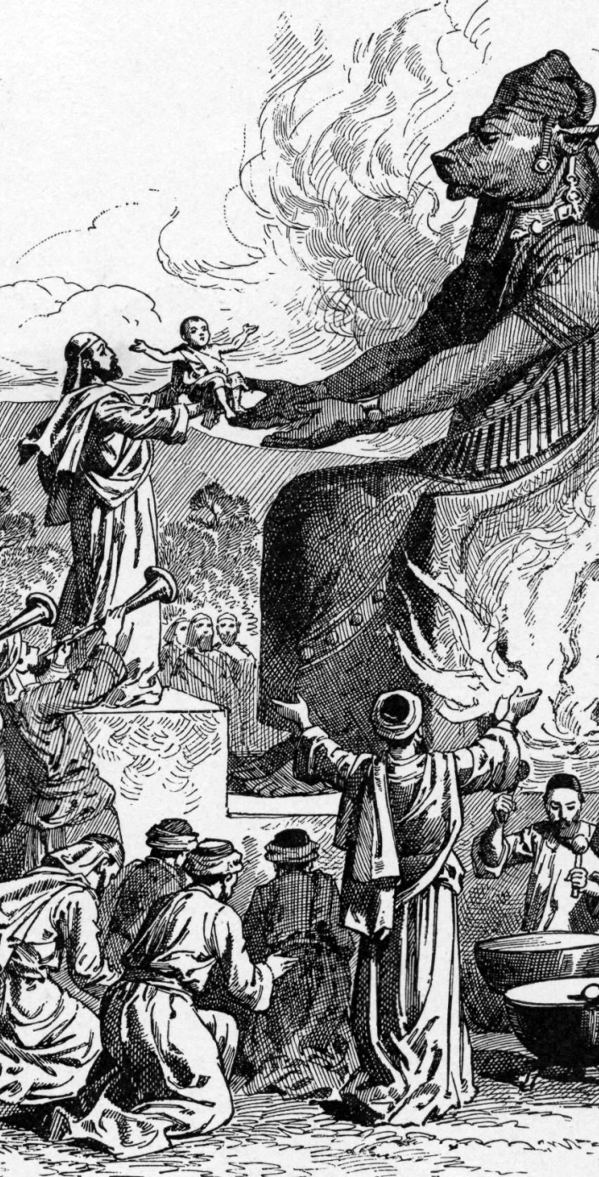
Israel & Molech ~1300 BC
Notes:
42:00-43:45
When Moses and Joshua led Israel into the promised land they failed to carry out God’s command to drive out the Canaanites and rather decided to assimilate and hang out with the pagan Canaanites instead. The Canaanites had the practice of sacrificing children to a deity named “Molech”. They would light a fire within a large idolatrous statue of Molech and then throw the baby inside. They believed that it would please Molech and that Molech would give them good weather for an abundant crop as a result. So, obviously, when the Israelites came to the promised land and saw all the amazing agricultural productivity that the Canaanites had they naturally asked “Hey, how do you make crops so good?” and the Canaanites responded “well, a few times a week we sacrifice a baby to Molech and he blesses us, duh! Better that a few stupid babies die than thousands of us real people die in a famine!” Then a lot of the Israelites were like “well, Yahweh said he’d provide for us and not to worship other gods…. Buuuuuutttttt…… those are some huge pomegranates and you guys do seem to know a lot about how to live, so I guess I’m down. Here’s my first born son.” and away they went. Hundreds of years later many Israelites, even several kings of Judah, still sacrificed children to Molech.
Long story short, God got upset and bad things happened. The valley where all this child sacrifice to Molech stuff happened took on the name of Gehenna, which is the same name used for hell in the bible… so yeah. Not cool.

Slide 20
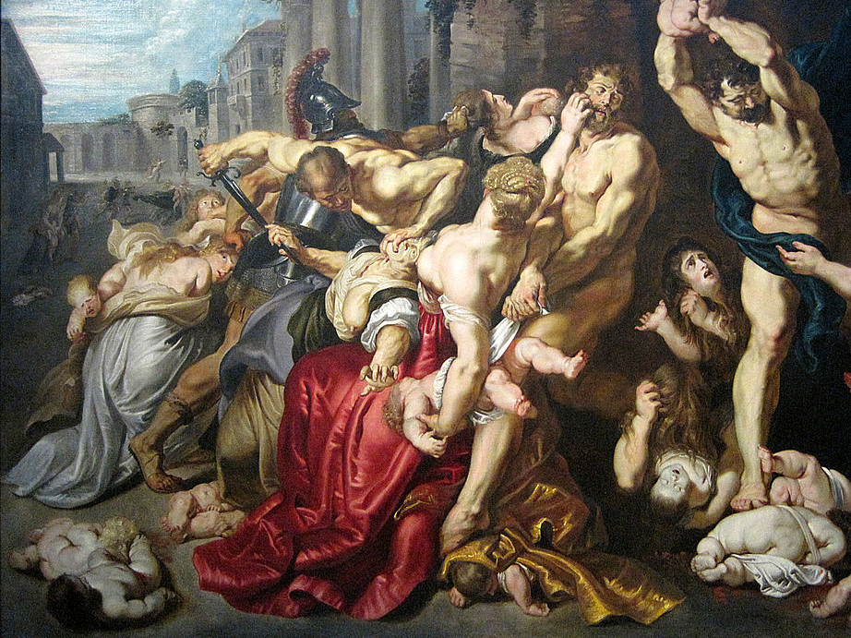
~1AD
King Herod
Notes:
43:45-44:00
Moving on, around the year 1 AD King Herod had all the babies in the area near where Jesus was born killed in an attempt to kill Jesus and prevent Jesus from taking his crown (Matthew 2:16-18).

Slide 21
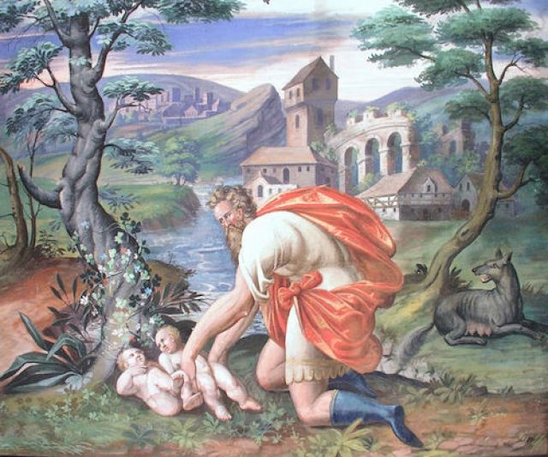
~100AD Roman Christians Adopt
~100AD Roman Christians Adopt
Notes:
44:00-45:30
Moving on, the Romans had this practice of just discarding kids they didn’t feel like raising. Girl when we wanted a boy? Have fun being abandoned in the snow kid. Born with a physical or mental defect? Trash! Look at this guy abandoning his kids, [point to slide with your arm and say the following emphatically by throwing your voice or otherwise changing your volume/demeanor to catch audience’s attention], he’s like “sorry boys, I have brown eyes and you have blue eyes and I ain’t tryin’ to feed mouths that weren’t conceived by me. I’ll just leave you here and if you’re lucky a she-wolf might nurse and raise you, as was the case with our city founder Romulus. Stupid pagan orgy festivals, they are so fun but they have such regrettable consequences…”.
In the first couple centuries after Christ, the first Christians were known for their generosity and imprudent selflessness. After avoiding getting killed during the day, by night they would roam the streets, dig through the trash, and wander the countryside explicitly in search of abandoned babies. They would then nurse them to health and raise them as Christians. So widespread was the practice of child abandonment that over the course of a couple centuries the number of Christians began to come close to the number of pagans, in no small part due to this practice of Christians adopting pagan invalids.
So yeah, a silver lining during a dark talk. I guess you could interpret this painting as the guy rescuing the kids if you want. Whatever makes you happy. Moving on.

Slide 22

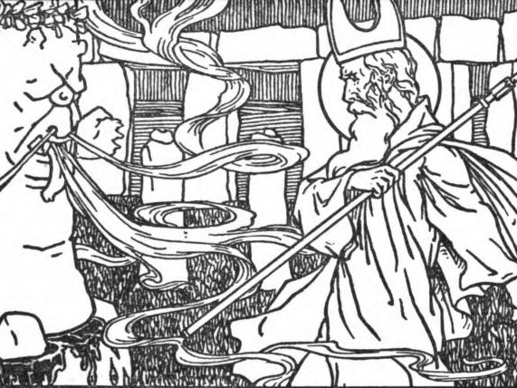
~440 AD Ireland
Cromm Cruach vs St. Patrick
Notes:
45:30-46:00
{My} Irish {ancestors} also dabbled in the whole child sacrifice thing. Most notably, there would be large statues of a deity called “Cromm Cruach” and the pagan priests would take babies by the feet and swing them head first against the statue. Around the year 440 AD St. Patrick came to town and after long struggles broke many of the idols and convinced most of the inhabitants of Ireland to worship Jesus instead of their idols.

Slide 23
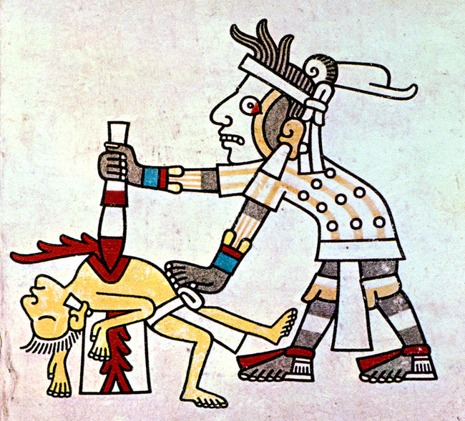
~1200-1531AD Aztecs
~1200-1531AD Aztecs
Notes:
46:00-47:00
Moving on, in America different natives practiced human sacrifice to various deities and among these were infants and pregnant women .
Around the year ~1200 AD what became the Aztec people migrated to the lands of modern day Mexico. The Aztecs were a strong foreign people from the north and other natives of the region lived in fear of the Aztecs and their brutality. The Aztecs had the habit of raiding the villages of other natives and taking live prisoners for the sole purpose of using them as live human sacrifices to their gods. And this was done on an epically large scale, with some records noting in excess of 20,000 people in a single festival being sacrificed in a single city (while other scholars estimate it may have been closer to many hundreds per year in whole empire on average and others sources estimating much much more. ). Spanish records from ~1520 note human sacrifices taken one at a time to have their hearts torn from their chests while still living to placate the Aztec gods.

Slide 24
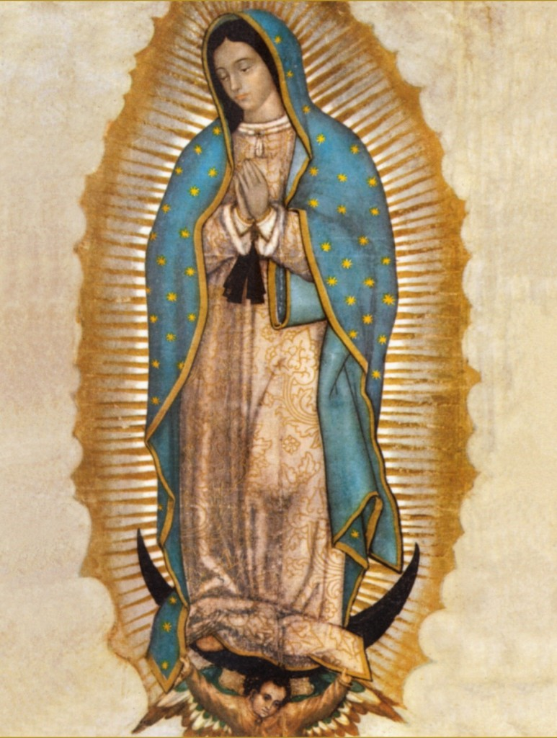
1531AD Our Lady of Guadalupe
1531AD Our Lady of Guadalupe
Notes:
47:00-47:40
After a decade of Spanish rule the Aztecs continued these human sacrifice practices and nearly none of the natives had converted to Christianity. It wasn’t until 1531 when Mary the mother of God as “Our Lady of Guadalupe” directly intervened in human history and single handedly converted the entire nation in just months. We will save that story for another day, but suffice to say Mexicans are super into this image of Mary for good reason {{ and so am I }}. Mary delivered us from a culture of death once and she can do it again! Our Lady of Guadalupe, pray for us!

Slide 25
Why did past civilizations practice infanticide?
Believed it would bring them economic success
Less people to split the inheritance with
Less mouths to feed
Legitimately thought the baby’s blood would lead to better crops
Didn’t value human life
Disproportionately enemy tribe babies anyway.
Notes:
47:40-48:20
The list could go on and on of more Christian encounters with infanticide & cultures of death through the centuries but we’ll stop there.
It’s weird, but apparently humans just drift into infanticide tendencies without divine intervention. Why did past civilizations practice infanticide?
[read slide]

Slide 26
Why do Americans abort?
Believe it will bring them economic success
Less people to split the inheritance with (Welfare)
Less mouths to feed (As if world is overpopulated)
Legitimately believe that they will be able to get a better job, education, etc if they don’t have to care for baby.
Don’t value human life
It’s disproportionately minorities that are affected. (27 Black, 18 Hispanic, 10 White abortions per 1,000 women aged 15-44)
Notes:
48:20-49:00
Now, lets look at a direct parallel because history repeats itself. Why do Americans practice abortion today?
[Read slides]
I guess the ancient humans aren’t so different than us after all.

Slide 27
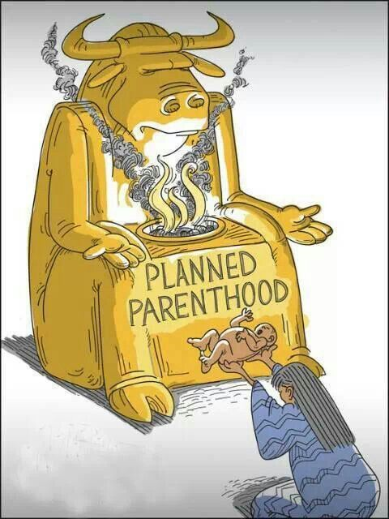
Present Day: $2k vs $240k vs >$1M
Notes:
49:00-51:30
So, there is nothing really different here compared to what the Israelites and Christians faced when confronting various pagan tribes throughout the centuries. The only thing shocking here is that our formerly Christian nation is suddenly willing to regress back to these barbaric practices.
Again, follow the dollars. The cost of raising a healthy baby to age 18 in general is ~$240,000, and this cost is higher if they end up in the foster care system, and much more if they are special needs.
So anyway, the attractive short sighted pitch is framed as "our government that is so in debt anyway could pay $2,000 for an abortion or it could be on the hook for $240,000 to raise that same child on welfare in our nanny state" and so many otherwise reasonable moral people see those big dollar signs and are instantly swayed to the Pro-Choice culture of death cause.
There is even a technology for detecting if babies have down syndrome in the womb that is advertised as "giving the parent a heads up and allowing them time to get support in place that they will need to deal with the child" but in reality has had the intentional or unintentional effect of triggering otherwise not abortion minded women into considering abortion and being pressured strongly into abortion from there. And various (mostly Scandinavian) governments with near 100% abortion rates for Down Syndrome babies are bragging that they have solved the Down Syndrome problem by simply murdering them all before their socialist government has to spend millions to take care of them.
We can talk Catholic economics and the ideal Catholic society another day… but unfortunately we’ve strayed far from that ideal in America. But please note in short that the $240,000 to raise child that sounds like a bargain to kill for $2,000 would have paid about a million dollars in taxes over their lifetime so even in a cold utilitarian viewpoint the government should still want to encourage not aborting children but people in general –and certainly politicians elected to office in 4 year stints- are not thinking long term and would much rather sacrifice long term health for short term gains.

Slide 28
Abortion in the USA
~1 million abortions per year
~64 million since 1973 when it was made legal
US Population is ~330 million
Abortion is~50x more casualties than all American wars combined
Planned Parenthood is the largest provider of abortions
Receives ~$530 million of government support every year
Notes:
51:30-52:00
So lets recap.
[Read slide]

Slide 29

An Important Mission
Notes:
52:00-53:10
The pro-life, anti-abortion movement is an important mission and I believe it will be what our generation is known for. Not only our generation but our nation. For example, the Aztecs did a lot of amazing things. They could predict stellar movements, track time, and build architecture in awe inspiring ways, etc... but is that the first thing that comes to your mind when you think “Aztec”? ...No, they are remembered for all the human sacrifice stuff.
Likewise, the USA put a man on the moon and established the internet among several other astonishing feats, but a few hundred years from now we may be chiefly remembered for 1 in 4 pregnancies ending in abortion. Sounds extreme, but the Aztecs sacrificed much less than 1 in 4 people so I could see it. So let's not let it get there.
In the same way Christians of the past have confronted infanticide and cultures of death heroically, now it is our generation’s turn to fight this evil and restore the hope and love of Jesus Christ to a country that has forgotten its Christian roots!

Slide 30

You could be the next Saint
Notes:
53:10-53:30
You could be the next great saint! Take the recent example of Saint Mother Teresa of Calcutta who won a Nobel peace prize and used the platform of her awards speech to speak out about abortion.

Slide 31
Saint Mother Teresa
“Many people are concerned with children of India, with the children of Africa where quite a few die of hunger, and so on. Many people are also concerned about the violence in this great country of the United States. These concerns are very good. But often these same people are not concerned with the millions being killed by the deliberate decision of their own mothers. And this is the greatest destroyer of peace today—abortion which brings people to such blindness.”
Notes:
53:30-55:00
Here is a quote from her Nobel Prize speech: [Read slide]
This is a woman who spent decades comforting the dying, ministering to the starving, the poorest of the poor in India, and instead of talking about food shortages she spends all her time going around talking about how bad abortion is, when the modern thinking is that if more people contracepted and aborted babies there would be less starving people.
Saint Teresa of Calcutta, pray for us!

Slide 32

Notes:
That's the end of the presentation but hopefully it's just the start of your lifetime of advocacy for the unborn and the Pro-Life movement! {{Here are some local and national pro-life groups that you can join. Particularly, the next local pregnancy resource center volunteer meeting is next Tuesday at 8pm at the parish center and I hope to see many of you there! }}

